Slide 1
Object detection
蔣圳嵐

Slide 2
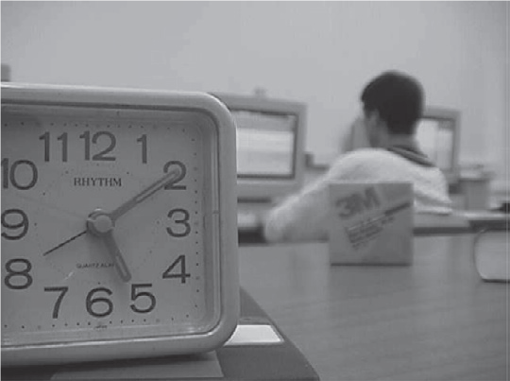
Motion
Divide the far area or near area by object(new), not pixel(old)
Lets suppose the clock on the left side of the image has total 500 pixels
when we use the old method
maybe it only detecte 300 pixels as near area
To avoid this problem if we say the clock is an object not pixels
Once detected the clock as a near area, the whole clock will be identified as the near area.

Slide 3
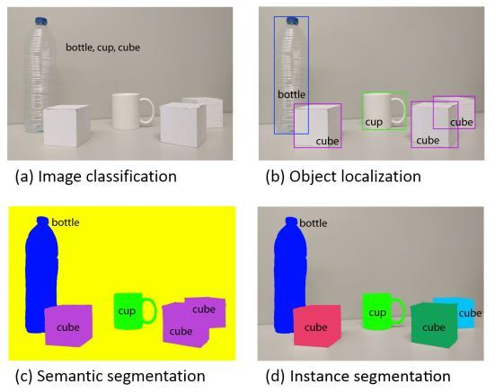
Task describe
Task describe:
There are four kind of task in the picture
In our problem we need task (d)

Slide 4
Task describe
So we need to use a technique called instance segmentation
Yolo is the most famous one in object detecting
But yolo can’t solve instance segmentation
So we use Mask R-CNN

Slide 5
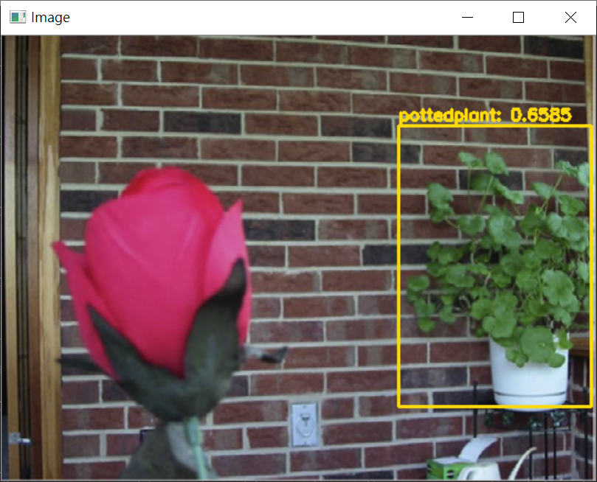
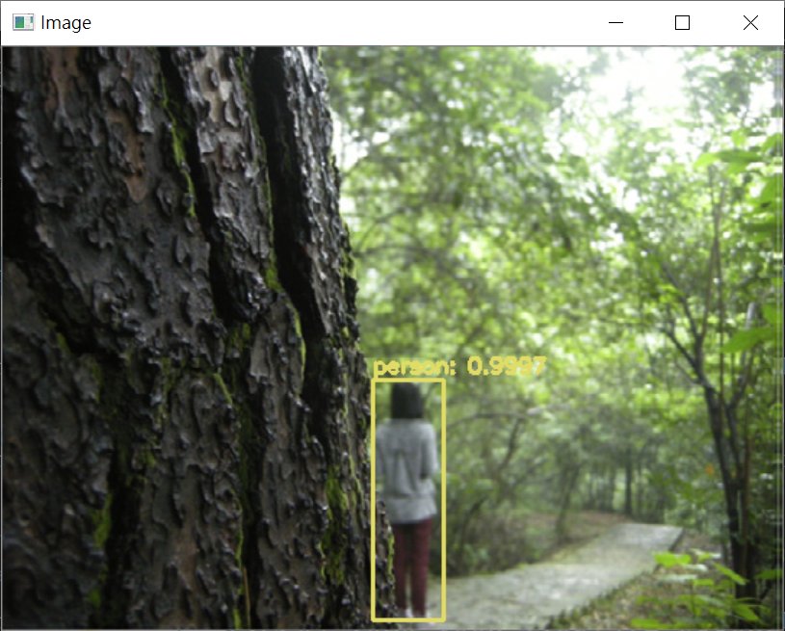
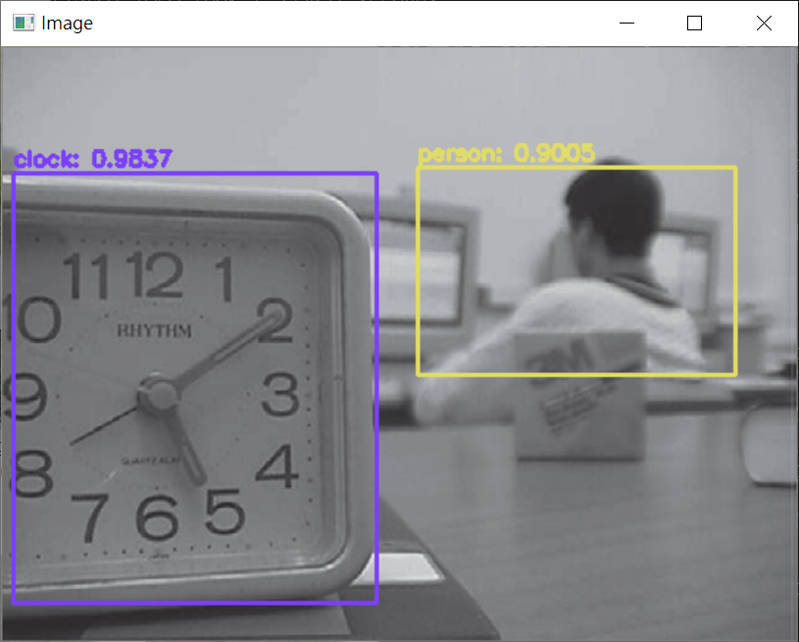
Yolo result
The result only have bounding box and class

Slide 6
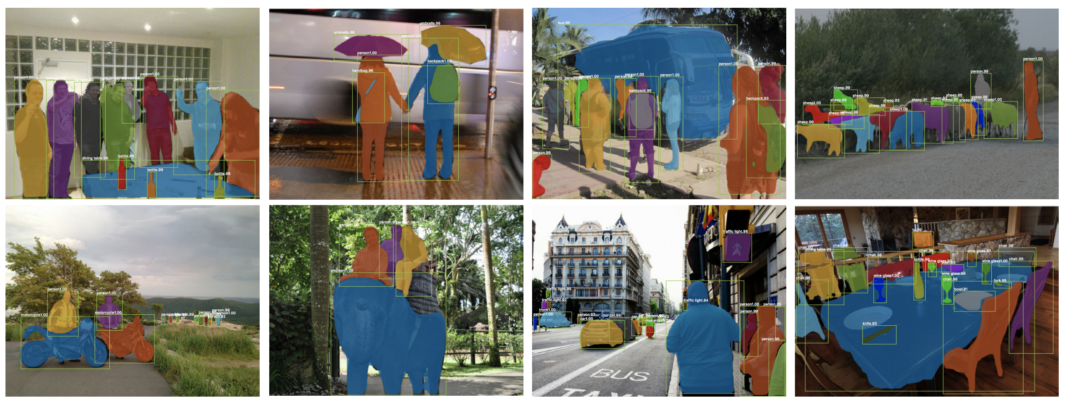
Mask R-CNN result

Slide 7
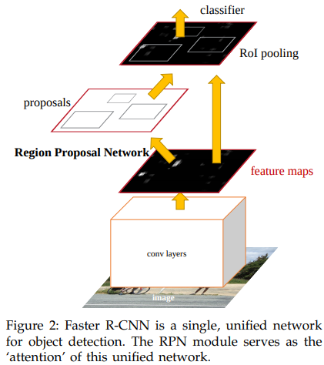
Faster R-CNN
Mask R-CNN is base on Faster R-CNN, a quick review of Faster R-CNN
First from CNN we get a feature map
Then use region proposal network（RPN）
Get RoI ( Region of Interest )
By RoI pooling to let all the ROI in the same size
Last using classifier ( Fully Connected Layer )
Get bounding box
Get class

Slide 8
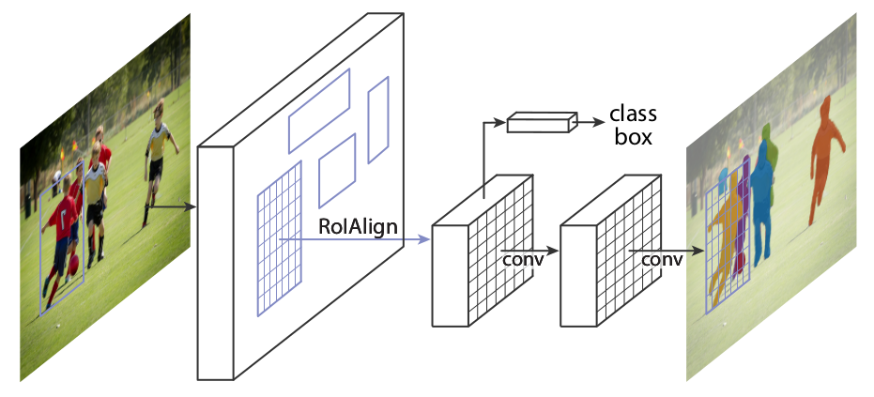
Mask R-CNN
First is doing the same in Faster R-CNN, feature map then get RoI
From here is different to Faster R-CNN
Doesn’t use RoI pooling ( Nearest neighbor Interpolation ), use RoIAlign(Bilinear Interpolation) instead
Add Fully Convolutional Network
Get a new output: segmentation masks

Slide 9
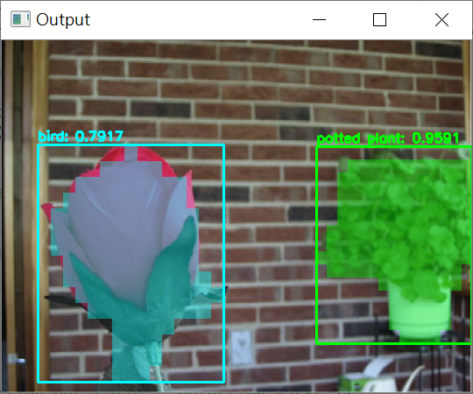
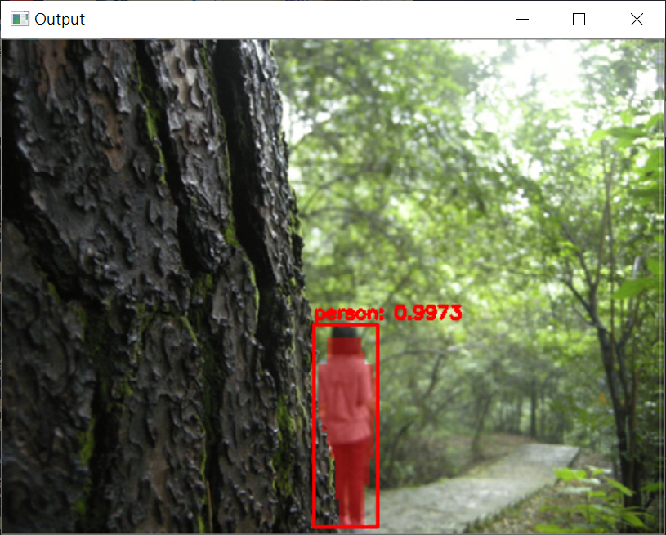
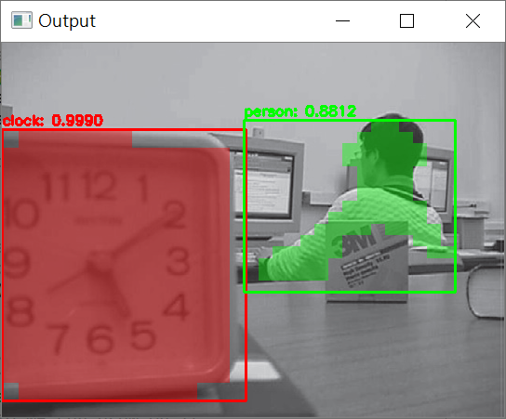
Mask R-CNN result
The model itself will pass a new output: segmentation masks

Slide 10
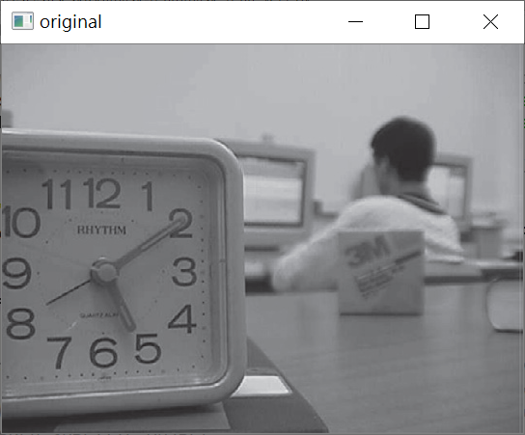
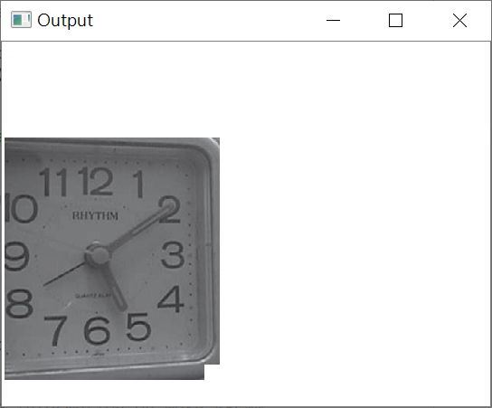
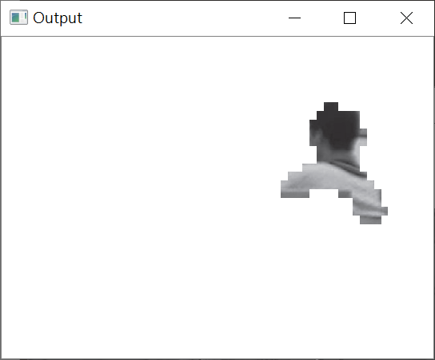
Final result
Delete the other part of the image, only remain one object in an image

Slide 11
Reference
https://medium.com/cubo-ai/%E7%89%A9%E9%AB%94%E5%81%B5%E6%B8%AC-object-detection-740096ec4540
A. Garcia-Garcia, S. Orts-Escolano, S. Oprea, V. Villena-Martinez, and J. Garcia-Rodriguez, “A Review on Deep Learning Techniques Applied to Semantic Segmentation,” cite arxiv:1704.06857Comment: Submitted to TPAMI on Apr. 22, 2017.
Kaiming He, Georgia Gkioxari, Piotr Dollar, Ross Girshick, “Mask R-CNN,” The IEEE International Conference on Computer Vision (ICCV), 2017, pp. 2961-2969

Slide 12
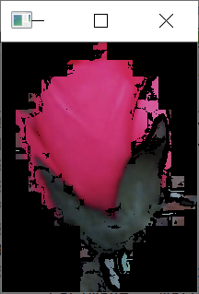
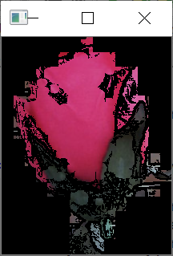
Problem
Far
Near

Slide 13
